Slide 1
StateKeeper: Generalizing Reachability
Vishrant Vasavada, Ricky Lee

Slide 2
Motivation
We don’t want a walking dead
QoS is the ultimate requirement - hence just verifying reachability isn’t enough
Most of the network verification algorithms don’t account for link delay, rate limiting rules (throughput), etc..
StateKeeper, along with reachability, gives operator the idea of overall delay a packet would suffer and throughput (rate limiting rules) of the system and verify the QoS specs
Notes:
Majority of the papers we studied so far do not account for link delays and rate limiting rules. These quantities highly affect quality of service. Hence, just verifying whether the packet reaches shouldn’t only be the goal but operator should also account for packet delay bounds and overall throughput. StateKeeper can allow operator to verify the QoS specs by giving idea of overall delay and throughput of the system when packet traverses from port i to port j

Slide 3
Two Approaches
NoD
Modify state of packet to be <header, quantity> where quantity could be delay/throughput
NoD uses difference of cubes ( DoC) data structure internally to represent packet states. We’ll have to change this DoC data-structure to support the above mentioned additions
Enhancing Atomic Predicate (AP) Verifier
AP Verifier computes reachability tree from Port i to Port j (Depth-First Search)
Each node on reachability tree has a set of forwarding and acl rules represented using the atomic predicates
The idea is to keep track of total delay and throughput while computing this reachability tree
Each port/node on reachability tree will have total delay and throughput observed so far
Notes:
Two approaches were considered. The first approach was to modify the state of packet in NoD to <header, quantity> where quantity would represent delay/throughput. However, this was too much work. This is because NoD uses DoC data structure internally to represent packet states and big modification would be needed in DoC data structure to support additions. We rather went by simpler approach. Use AP Verifier approach and while calculating reachability tree, also keep track of delay and throughput observed so far at each port.

Slide 4
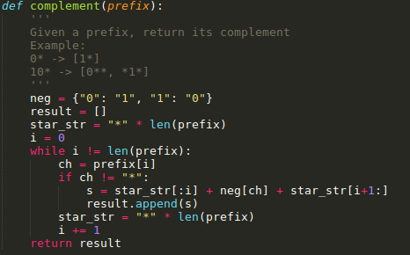
Header Space Algebra
Complement: 1* -> 0*, 10* -> 0**, *1*
For every non-star character, replace it by a negation and replace/keep all other characters by/as *

Slide 5
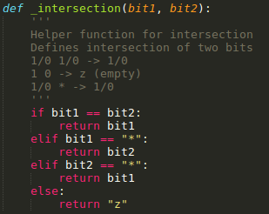
Header Space Algebra
Intersection
1/0 1/0 -> 1/0, 1 0 -> z (empty), 1/0 * -> 1/0

Slide 6
Atomic Predicates
Steps:
Sort the prefixes in increasing order of their length
For each prefix, get {Prefix, Prefix’} pair where Prefix’ is complement of Prefix
Find atomic predicate set for each prefix
Complement:
1* -> {1*, 0*}
10* -> {10*, [0**, *1*]}
Atomic Predicates for each prefix:
{1*, 0*} -> {1*, 0*}
{10*, [0**, *1*]} -> {10*, [0**, *1* - 0**]} -> {10*, 0**, 11*} (Difference is just intersection with complement)
Notes:
In the last line, by doing {10*, [0**, *1*]} -> [0**, *1* - 0**], we are just getting rid of all prefixes in *1* that intersect with 0** by subtracting 0** from *1*. Difference is just an intersection with complement i.e. *1* - 0** = *1* intersects Not(0**) = *1* intersects 1** = 11*.

Slide 7
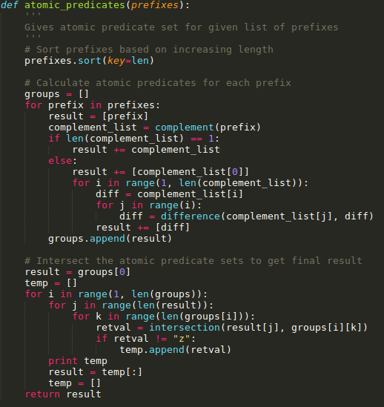
Atomic Predicates (contd…)
Intersect atomic predicate set of prefix 1 with prefix 2, then the result with atomic predicate set of prefix 3 and so on...
Atomic Predicates for each prefix:
{1*, 0*} -> {1*, 0*}
{10*, [0**, *1*]} -> {10*, [0**, *1* - 0**]} -> {10*, 0**, 11*}
Atomic Predicates:
{1*, 0*} intersects {10*, 0**, 11*} -> {10*, 11*, 0**}

Slide 8
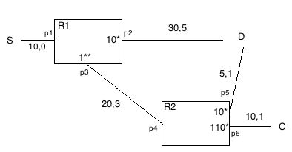
Example: Topology Diagram
D = Destination
S = Source
(a, b) tuple = (throughput, delay)
----------------------------------
Reachability:
S->P1->P2->D: 10*, (10, 5)
S->P1->P3->P4->P5->D: 10*, (5, 4)
Notes:
We can reach D in two ways:
S -> P1 -> P2 -> D. The packets reaching here will match 10*. Delay suffered will be 5 (0 + 5) and throughput will be 10 (min(10, 30)).
Another way is S -> P1 -> P3 -> P4 -> P5 -> D. The packets reaching here will again match 10*. Delay suffered will be 4 (0 + 3 + 1) and throughput will be 10 (min(10, 20, 5)).

Slide 9
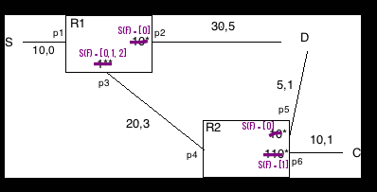
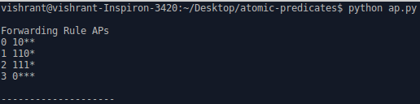
Example (contd…): Atomic Predicates
Notes:
The first step is to get atomic predicates for the given forwarding rules.
When you run our code, we get the output as shown in right figure. 0, 1, 2, 3 are simply the labels for corresponding atomic predicates. We’ll replace forwarding prefix at each port with set of atomic predicates (S(F)).

Slide 10
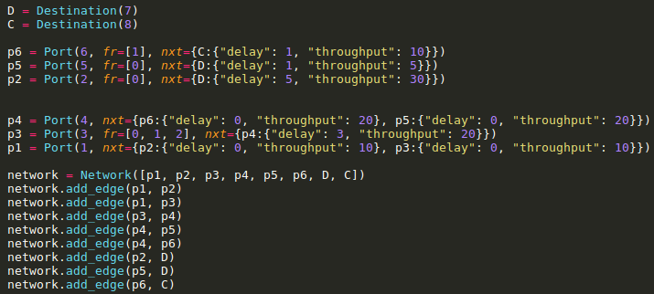
Example (contd…): Modelling the network
A graph with port has vertices and physical links between ports as edges
Each port has ID, set of forwarding rules (represented with integers corresponding to atomic predicates), set of ports it is directly connected to along with the link delay and throughput info
Notes:
Once we get the atomic predicates, we model the topology using them. We represent the network topology as simply a graph with ports as vertices and links between ports as edges. Each port will have ID, set of forwarding rules represented with integers corresponding to the atomic predicates and set of ports it is directly connected to along with the link delay and throughput info.

Slide 11
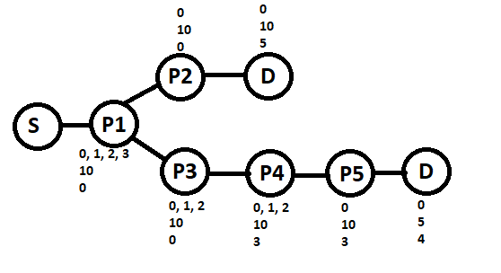
Example (contd...): Reachability Tree
DFS Algorithm
Notes:
Here we show reachability tree for the given network.
The top numbers represent atomic predicate set (S(F)) for forwarding rules at each port, then there’s throughput and finally there is delay.
Reachability tree is obtained by running DFS algorithm.

Slide 12
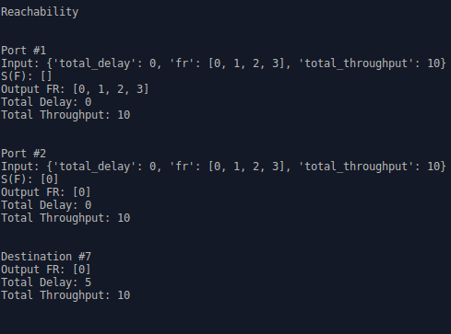
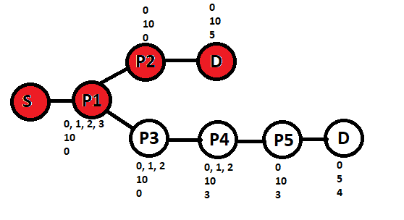
Example (contd…): Reachability Tree
Notes:
When you run the code, it prints out all possible branches in reachability tree. For example, the figure to the right shows that to reach D, one way is to go from port #1, t port #2 and then to Destination (D). The output FR predicate is 0 which is 10* as seen earlier. The total delay is 5 and throughput is 10.

Slide 13
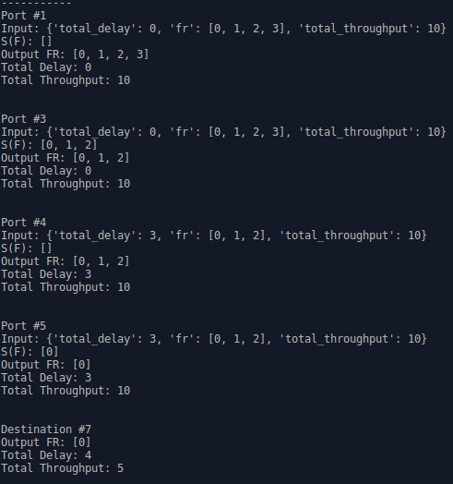
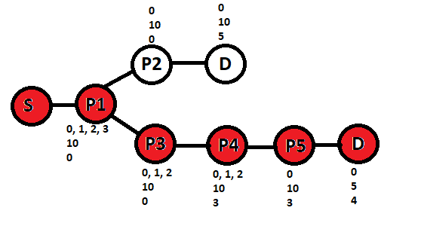
Example (contd…): Reachability Tree
Notes:
Similarly, here’s the other branch.

Slide 14
Comments
Same time complexity as AP Verifier
Limitation: Doesn’t take liveliness into account
Notes:
It will be same time complexity as AP Verifier as we don’t have to traverse or do more work for storing delay and throughput.
Limitation: Let us consider link delay. It accounts for theoretical known link delay but doesn’t account for liveness. Actual delay might increase if there’s temporary congestion in the link. However, this could then help operators detect congestion or that something phishy is going on.

